Slide 1


Biometrics
Oleh :
Riyanto Sigit
Penyaji :
Rengga Asmara

Slide 2
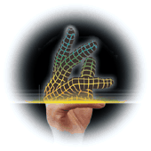
Apakah Biometrics?
Suatu metode secara otomatis untuk mengenali menggunakan anggota tubuh atau ciri tertentu.
Sistem biometrics berisi sistem pengenalan pola, mengenali seseorang dengan menggunakan keaslian anggota tubuh secara khusus oleh pemakai
Ciri yang digunakan oleh Biometrics meliputi :
  Sidik jari
  Suara
  Wajah
  Tulisan Tangan/Tanda Tangan
  Pola Retina
  Geometri Tangan
  dan sebagainya…

Slide 3
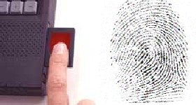
Mengapa Biometrics
Keamanan
Kunci untuk keamanan
Verifikasi/Pengenalan

Slide 4
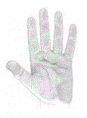
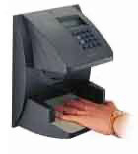
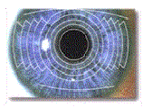
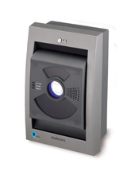
Sistem Biometrics
Tipe Biometrics
  Sidik Jari, Suara, Wajah, Tulisan Tangan, Tanda Tangan, Pola Retina, Geometri Tangan
Physiological / Behaviour

Slide 5
Tipe Sistem Biometrics
Contoh Fisik
Contoh → Biometrics Template
Bandingkan dengan template di database
Konfirmasi
Sample Capture
Feature Extraction
Template
Comparison
Matching

Slide 6
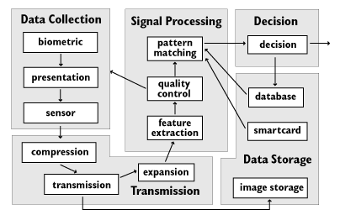
Diagram Biometrics

Slide 7
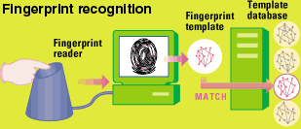
Pengenalan Sidik Jari
Fingerprint-recognition system scans finger from several angles and store the template on a server or local hard disk
These systems can have good accuracy

Slide 8
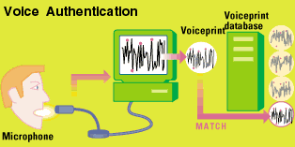
Pengenalan Suara
Voice-authentication systems can create voiceprint based on the inflection points of speech, emphasizing the highs and lows specific to the way of user’s talking

Slide 9
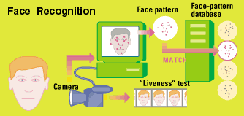
Pengenalan Wajah
Face-recognition software uses a camera attached to the PC to capture and map key identifying features. Some also perform a "liveness" test to see how the face moves, so that a photo of user cannot be used.

Slide 10
Dimana Digunakan
Biometrics is a rapidly evolving technology which is being
widely used in
Criminal Identification
Prison Security
ATMs
Cellular Phones
Smart Cards
Desktop PCs
Workstations and Computer Networks
Access to Buildings, Offices, and Other Secure Areas
Companies and Government use it to secure databases and authenticate people over the phone, over the computer, and via cameras.

Slide 11
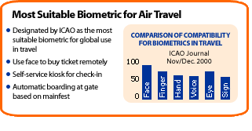
Perbandingan Biometrics

Slide 12
Question ?
End of Session

